Slide 1
Lung Foundation New Zealand Patient advocacy group dedicated to increasing survival for lung cancer 2022 July - New Zealand Lung Cancer Conference (Auckland)
Assoc Prof Chris Atkinson, Medical Director
Philip Hope, Chief Executive

Slide 2
Introduction
Lung Foundation NZ is a non-government organisation (patient advocacy group) dedicated to increasing survival for lung cancer.
The Lung Foundation provides information and support for lung cancer patients and carers and is devoted to advocating on a range of issues, including; prevention, early detection (screening), stigma, public access to more effective treatments, an increase in research funding and a commitment to Smokefree 2025.
Vision
New Zealanders know how to keep their lungs healthy and they investigate symptoms of lung disease earlier.
Kaupapa
To increase survival for lung cancer
Goals
- Promote Lung Health
- Promote Early Diagnosis of Lung Disease
- Reduce Lung Cancer Deaths
Notes:
Our Vision
New Zealanders know how to keep their lungs healthy and they investigate symptoms of lung disease earlier.
Our Mission
To increase survival for lung cancer
Our Goals
Promote Lung Health
Promote Early Diagnosis of Lung Disease (Lung Cancer)
Reduce Lung Cancer Deaths (Long term goal)
NB: These goals are also advocacy priorities

Slide 3
Our Values
Rangatiratanga; we have integrity, we empower people, we say what we mean.
Manaakitaka, we nurture and respect people’s mana.
Whanaungatanga, collaborating to improve healthcare in Aotearoa, also serves future generations.
Notes:
Our Vision
New Zealanders know how to keep their lungs healthy and they investigate symptoms of lung disease earlier.
Our Mission
To increase survival for lung cancer
Our Goals
Promote Lung Health
Promote Early Diagnosis of Lung Disease (Lung Cancer)
Reduce Lung Cancer Deaths (Long term goal)
NB: These goals are also advocacy priorities

Slide 4
Lung Cancer in Aotearoa
Lung cancer is NZ’s BIGGEST CANCER KILLER
5 Kiwis die every day from lung cancer
6 Kiwis are diagnosed with lung cancer every day
More Kiwis die of lung cancer than breast cancer, prostate cancer and melanoma combined.
45% of patients diagnosed with lung cancer in NZ are diagnosed at A&E
There is a 6% gap in three-year survival rate between NZ and Australia. This gap is growing.
ANYONE can get lung cancer!

Slide 5
Māori suffer extreme inequity
One Māori dies of lung cancer every day in New Zealand.
Lung cancer registrations and mortality rates are 4 times higher in Māori women and nearly 3 times higher in Māori men.
Lung cancer is the leading and second highest cause of death in Māori females and males respectively.
Despite, lung cancer being New Zealand’s biggest cancer killer, we DO NOT yet have a national lung cancer screening programme in place…
New Zealand has singled out inequities for Māori as a priory, however the lack of commitment to reduce inequalities is indefensible and unacceptable.

Slide 7
Lung Cancer Treatments
Notes:
The infographic below compares the number of treatments for Non-Small Cell Lung Cancer (NSCLC) in New Zealand, with Australia and Europe (NSCLC = 85% of all lung cancers). New Zealand funds just five treatments for lung cancer, in comparison to Australia which funds 17 treatments.
This huge imbalance goes some way to explain the 6% gap in three-year survival rate between NZ (2015 - 2017) and Australia (2013 - 2017).
This gap is only going to grow.

Slide 8
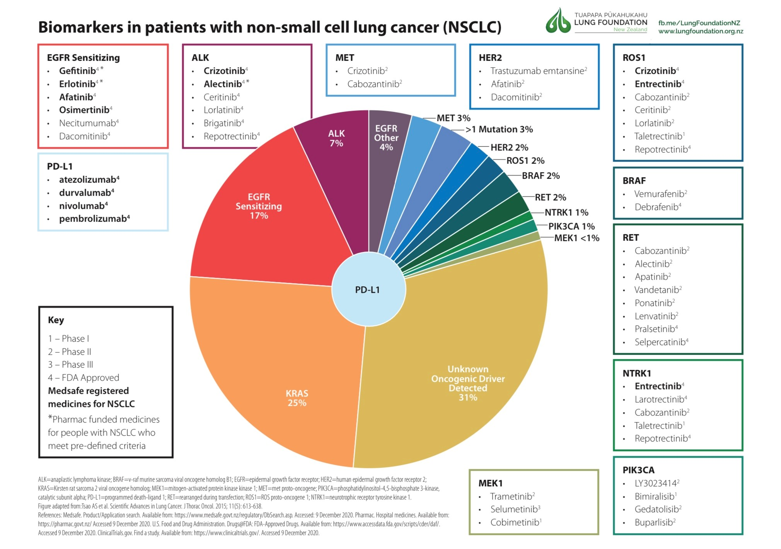

Slide 9
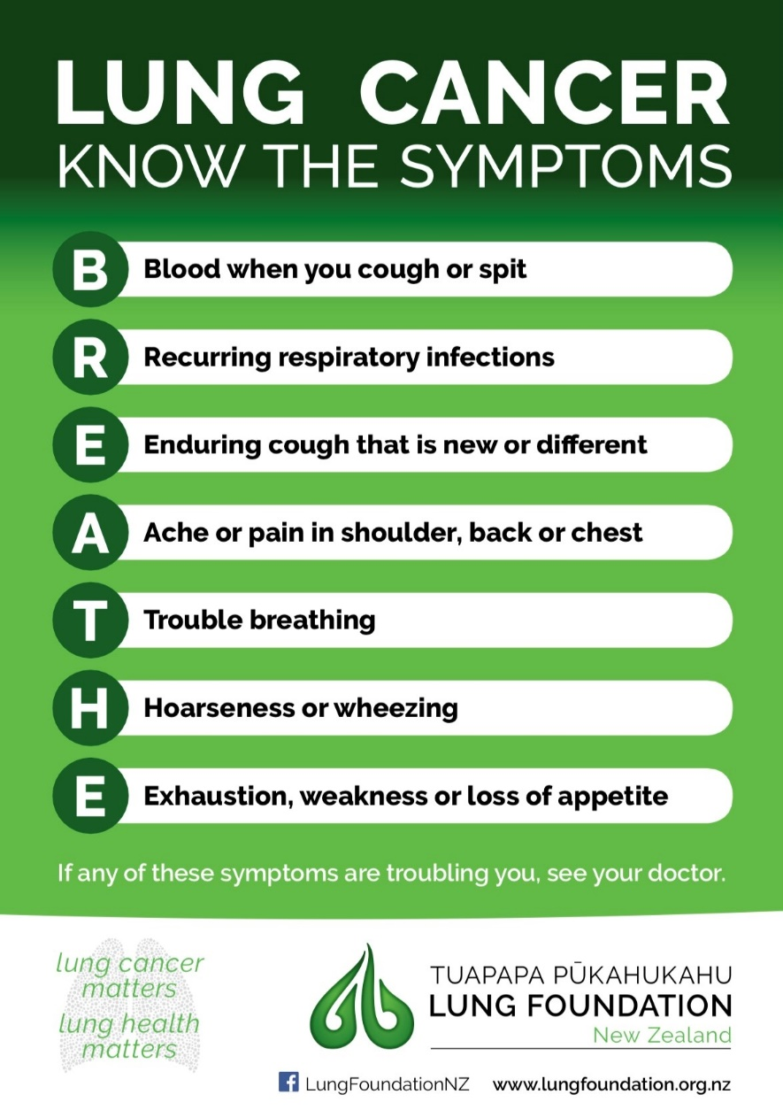
Lung Cancer Awareness
Notes:
The infographic below compares the number of treatments for Non-Small Cell Lung Cancer (NSCLC) in New Zealand, with Australia and Europe (NSCLC = 85% of all lung cancers). New Zealand funds just five treatments for lung cancer, in comparison to Australia which funds 17 treatments.
This huge imbalance goes some way to explain the 6% gap in three-year survival rate between NZ (2015 - 2017) and Australia (2013 - 2017).
This gap is only going to grow.

Slide 10
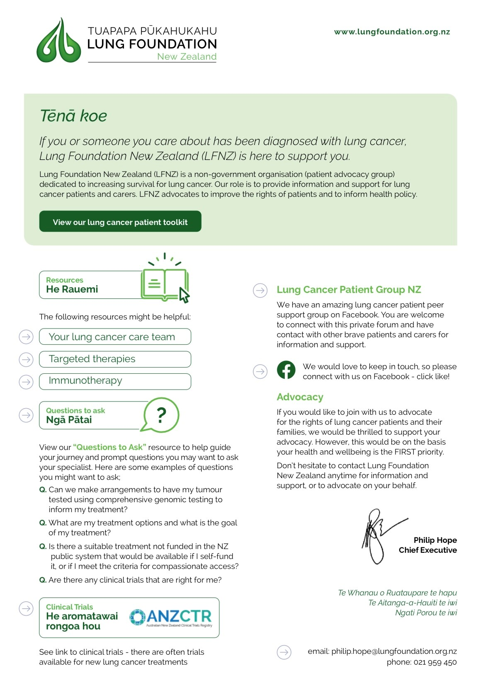
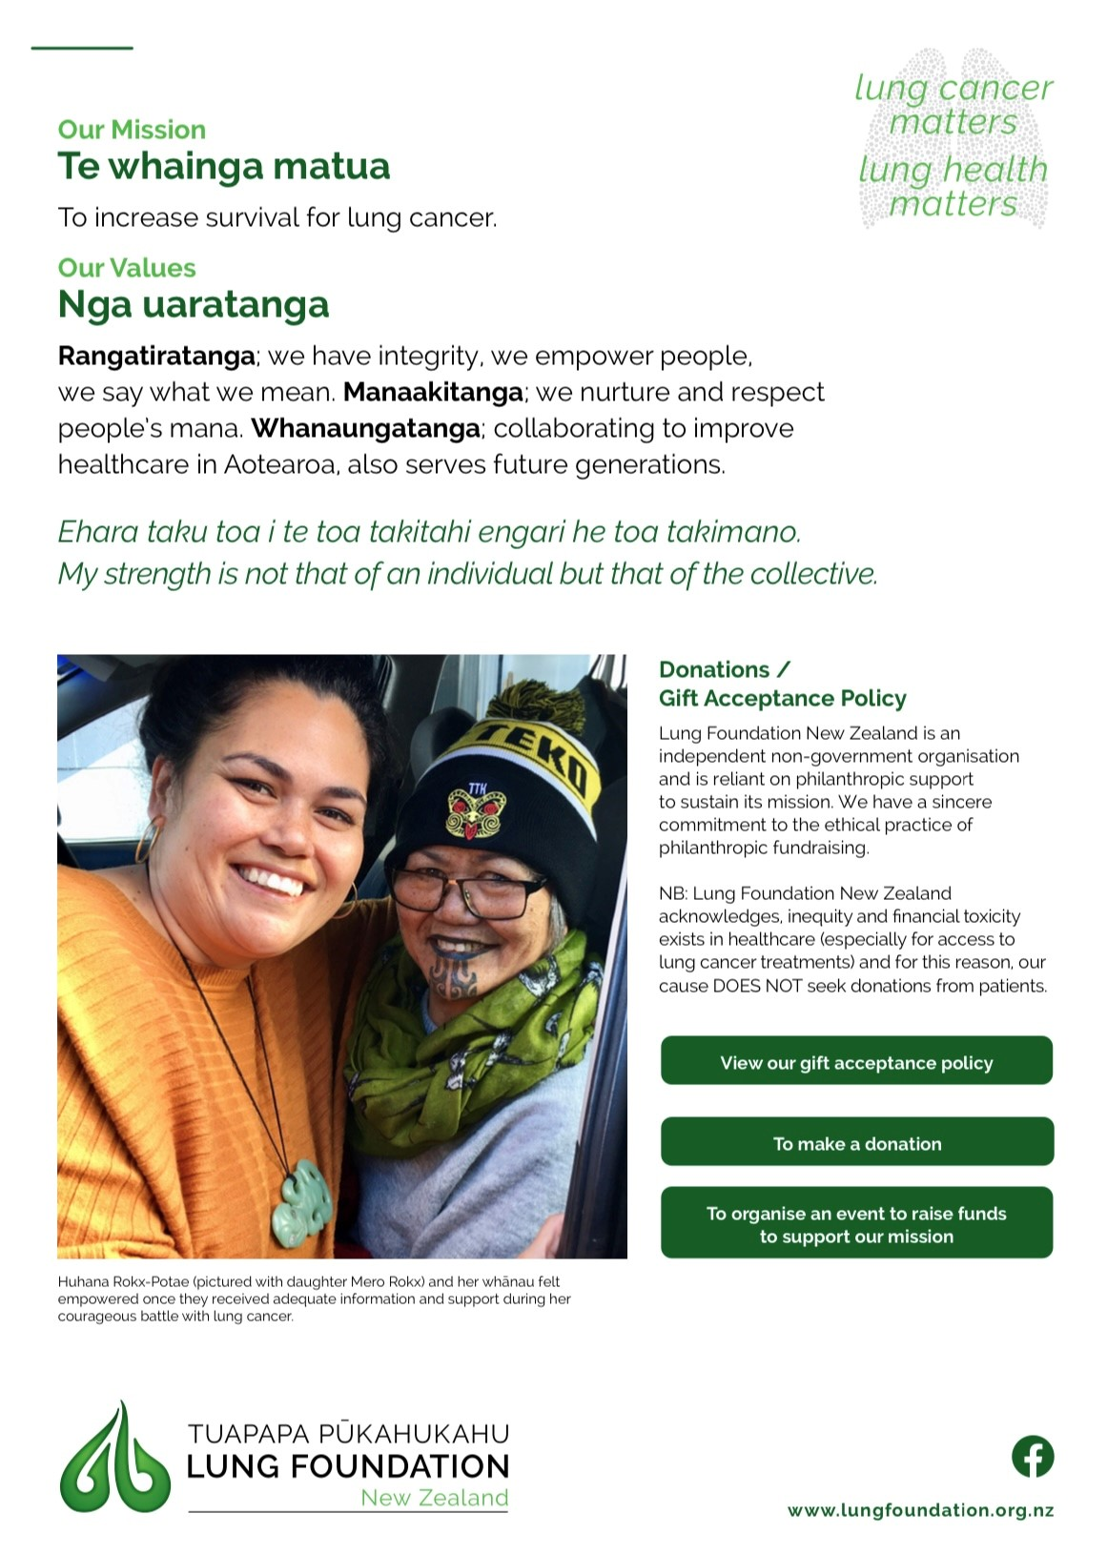
Lung Cancer Patient Resources
Notes:
The infographic below compares the number of treatments for Non-Small Cell Lung Cancer (NSCLC) in New Zealand, with Australia and Europe (NSCLC = 85% of all lung cancers). New Zealand funds just five treatments for lung cancer, in comparison to Australia which funds 17 treatments.
This huge imbalance goes some way to explain the 6% gap in three-year survival rate between NZ (2015 - 2017) and Australia (2013 - 2017).
This gap is only going to grow.

Slide 11
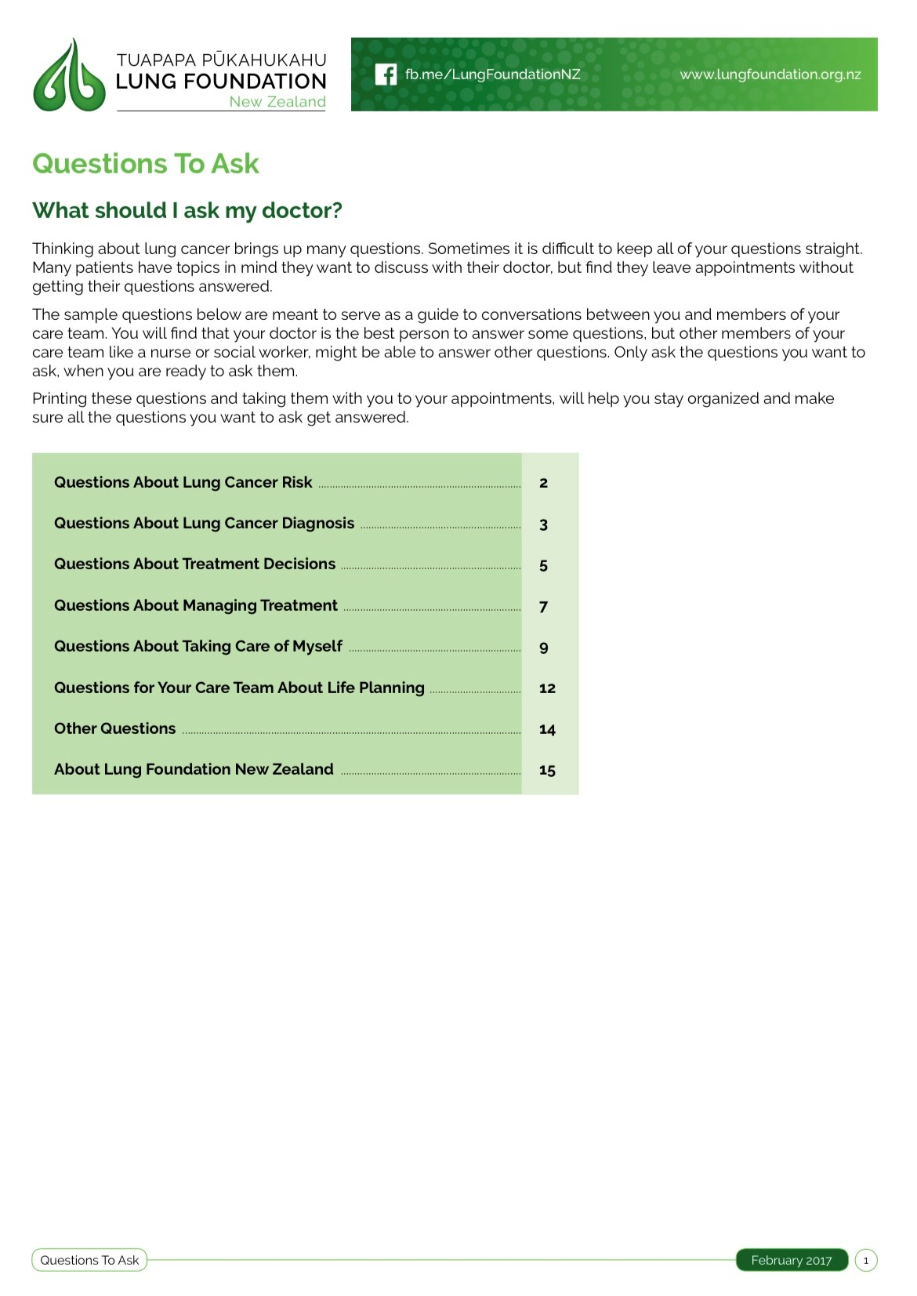
Lung Cancer Patient Resources
Notes:
The infographic below compares the number of treatments for Non-Small Cell Lung Cancer (NSCLC) in New Zealand, with Australia and Europe (NSCLC = 85% of all lung cancers). New Zealand funds just five treatments for lung cancer, in comparison to Australia which funds 17 treatments.
This huge imbalance goes some way to explain the 6% gap in three-year survival rate between NZ (2015 - 2017) and Australia (2013 - 2017).
This gap is only going to grow.

Slide 12
Lung Cancer Patients
Patients want to Live and not to be stigmatised.
Osimertinib (Tagrisso) current funding
1st Line EGFRm+ = 59 countries
2nd Line T790M+ = 71 countries
Pembrolizumab (Keytruda) current funding
1L monotherapy for PD-L1 TPS ≥ 50% patients = 53 countries
1L combination therapy = 49 countries
Patients want access to the standard of care provided in comparable countries.
Patients want lung cancer specialists and patient representative to be consulted with all decisions regarding assessment and reimbursement of treatments.
Need (Burden of Disease)
Health Benefits
Costs and Savings
Suitability
Patients want transparency in how the framework is applied by Pharmac to individual treatments....
Patients want a dedicated fund for cancer treatments
Notes:
Patients want transparency in how the framework is applied to individual treatments .... This is a separate issue to the waiting list.
https://www.pharmac.govt.nz/about/2016/factors/

Slide 13
Primary Healthcare and Lung Cancer
>20% of Kiwis with lung cancer have never smoked BUT ARE STIGMATISED
only 25% of Kiwis diagnosed with lung cancer still smoke ASK “HAVE YOU EVER SMOKED”
Lung Cancer can be treated. The earlier the detection the better the outcome.
Lung Cancer has many different gene mutations THEREFORE MANY TARGETED THERAPIES AND IMMUNOTHERAPIES
Most are not funded in NZ.
We share responsibility - Together we can address this!

Slide 14
Lung Cancer in New Zealand
do you think that:
Lung Cancer should be a national health emergency
you and your practice can advocate for better outcomes for lung cancer in New Zealand
what symptoms should HCP’s be alert to
what symptoms would you screen / and how
how do we better integrate primary / secondary care
WE ARE IN THIS TOGETHER

