Slide 1
Patient Involvement in Health Technology Assessment
“No decision about me without me”
Simone Leyden – CEO The Unicorn Foundation

Slide 2
Patient Involvement in Health Technology Assessment
Who we are, why we are here?
What is Health Technology Assessment (HTA)?
Stakeholders
International landscape
What is Health Technology Assessment International (HTAi)?
Best practice examples
How can patient groups influence HTA – Australian experience

Slide 3
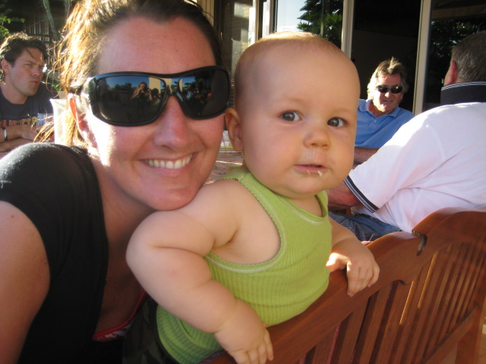
Who is the Unicorn Foundation?
Founded in late 2009 by brother and sister Dr John Leyden and Simone Leyden due to their experience with their sister Kate. The Unicorn Foundation is Australia’s only not for profit medical charity supporting patients suffering from neuroendocrine (NET) cancers.
Unicorn Foundation New Zealand started in 2013 – Siobhan Conroy
The Mission of the Unicorn Foundation is:
to assist and support patients and carers, through support groups and access to networks of expertise
to lobby for access to new and appropriate investigations and treatments
to raise awareness and knowledge of neuroendocrine cancers within the medical community and general public
to encourage and support Australian research in the area of neuroendocrine cancers

Slide 4
What is Health Technology Assessment (HTA)?
What is HTA? : “systematic evaluation of the properties and effects of a health technology, addressing the direct and intended effects of this technology, as well as its indirect and unintended consequences” [1]
Clinical effectiveness, cost-effectiveness, safety, social and economic characteristics [2]
Aim of HTA is to make evidence-based decisions about public funding of health technologies [3] (pharmaceuticals, diagnostics tests, medical devices, and procedures)
Recognising the importance of patient involvement – not been extensive but slowly growing internationally
Perceptions vs evidence
Notes:
Clinical effectiveness….- depends on regulatory body, for instance the TGA Therapeutics Good Administrations looks at harm vs benefits and primarily “do the benefits outweigh the risks and where there are uncertainties they are acceptably small”. They do not look at financial toxicity that is the role of the reimbursement body, PBAC.
There is an overwhelming need to develop more systematic approaches to considering patients and public perspectives in HTA as they add key dimensions to the evaluation process that might otherwise be overlooked.

Slide 5
Key Stakeholders in the HTA Process
Reimburse-ment decision makers
HTA agencies
Pharma Group
Payers
Patients
Doctors
Media
HTA Experts
Hospitals
Patient Organisations Research Organisations
Notes:
HTA Agencies – Pharmaceutical Benefits Advisory Committee, Therapeutic Goods Administration, Medical Services Advisory Committee
TRANSPARENCY IN THE PROCESS IS KEY
Govt – need for creation of policies that support innovation, incl tax, trade, intellectual property and reimbursement to make drug access easier
Pharma Group – understanding the high price of R&D which was highlighted in the last couple of days by Pfizer CEO Ian Read, suggesting in a speech that Australia and New Zealand (Canada and UK) were free loading of US investment in R&D. He estimated the cost of drug development has soared to $2.6 billion
Patients – should be involved in 3 different stages prioritisation (FDA rare drug consultations, CADATH workshops), evidence assessment (consumers on assessment committees, consumer hearings, dissemination of evidence (PBAC workshop to make the public summary more understandable access to drugs but at what cost, quality of life v progression free survival)
Doctors – clinical trials access for patients
Payers – most economic sound decision for the community

Slide 6
















Summary of Patient involvement Globally
Different Roles of Patients in HTA
Patients are invited to provide comments
Patients have a voice in the appraisal committee
Systematic process to include patient views
Lack of patient involvement
Mexico: No patient involvement, experts can be requested by the manufacturer
South Africa:
No patient involvement, experts can be requested by the manufacturer
Italy and France: No patient involvement
Brazil, Poland, Netherlands and South Korea:
Patients are invited to provide comments on the assessments
Taiwan: Patients can be invited to the appraisal committee
Thailand: Patients can be included in the committee to select HTAP research topics
Germany: Patients participate through the whole process contributing to the methodology of the assessment and sit in the appraisal committee.
Australia and Sweden: Patients are included in appraisal committee.
Scotland: Patients participate through the whole process. SMC collects their views and they have a role in the appraisal committee.
England: Like SMC without voting rights in the appraisal committee
Canada: CADTH systematically collect patient views
Notes:
Taken from a presentation last year at HTAi in Tokyo, sadly NZ was not on the list in regards to patient involvement

Slide 7



International “best practice”- patient involvement in Health Technology Assessment
Notes:
Canadian Agency for Drugs and Technology in Health – it was a presentation from a representative from pCODOR or the pan-Canadian Oncology Drug Review that got me interested in 2014 – consumer workshops similar to FDA
National Health and Science Scotland
NICE's approach to patient and public involvement is based on two key principles:
that lay people, and organisations representing their interests, have opportunities to contribute to developing NICE guidance, advice and quality standards, and support their implementation, and
that, because of this contribution, our guidance and other products have a greater focus and relevance for the people most directly affected by our recommendations.

Slide 8
Public Involvement Programme (PIP)
Supports the involvement of patients, service users, carers
and the public across NICE work programmes
Advises NICE & its collaborating centres on methods of involvement
Identifies
participants
(organisations and
individuals)
Provides information,
training and support to lay people who
engage with NICE (as individuals
or organisations)
  http://www.nice.org.uk/about/nice-communities/public-involvement/patient-and-public-involvement-policy
NICE Presentation – Laura Norburn HTAi Tokyo 2016
Notes:
PIP - 12 people in teams based across London and Manchester
Key objective ‘to support the involvement of patients, service users, carers and the public across NICE work programmes’.
We work across NICE to help ensure this happens, and with the different guidance producing teams on relevant issues for patients and the public.
Achieve this with the following 3 key actions:
1. Advise NICE and its collaborating centres on methods of involvement.
2. Identify participants (orgs and indiv.) to be ionvovled in the development of any NICE reccomendations. There is also a policy, supported by the PIP, that all NICE standing and ad hoc advisory committees should include at least two lay people.
3. Once people are appointed to groups or committees, we work with them throughout their participation, offering dedicated induction and ongoing support.

Slide 9
The nature of evidence
Patient evidence
Clinical evidence
High quality patient care
(Relevant, effective, acceptable, appropriate)
Economic evidence
Acknowledgement: Dr Sophie Staniszewska, RCN Research Institute, University of Warwick
Notes:
Clinical and economic research evidence has a long history of conceptual and methodological development – patient evidence not so and doesn’t have the same recognition – so this is a big challenge for NICE and others
all 3 types of evidence are vital – we need to ensure that committees have appropriately considered what is important from a patient perspective, including how relevant, acceptable and appropriate a treatment or service is.
Patient evidence is used in NICE guidance (from existing research and from patient involvement) - lay people on committees help to ensure patient perspectives are considered (also patient stakeholder input).

Slide 10
4 Key Stakeholders in NICE Process
Lay members: 2 lay people on each appraisal committee
National charities: national patient organisations can comment on draft recommendations and provide submissions
Patient experts: individual patients/carers can attend meetings and provide personal statements
Public: anyone can comment on draft recommendations
NICE Presentation – Laura Norburn HTAi Tokyo 2016
Notes:
Database of 2000 patients and groups to call on when a drug goes up for assessment to guarantee feedback.
Budgets set aside to up keep this registry, investment needs to be made to engage!

Slide 11
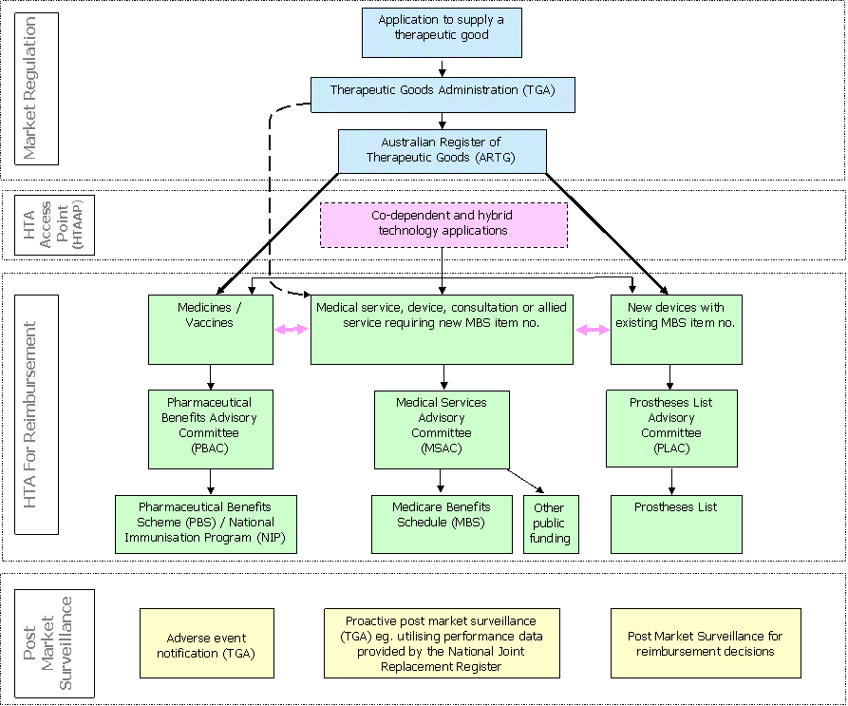
Map of current Australian Government HTA processes for market entry and reimbursement
Notes:
Confusing much?
One patient rep on each committee, PBAC, MSAC and PLAC - patients can make submissions

Slide 12
Seventeen-week submission process to PBAC
Notes:
Consumer comments come in at the very end in a 6 week opening (used to be 2 weeks), consumer hearings have just been introduce over the last 18 months

Slide 13
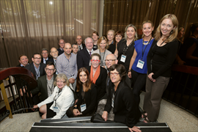
How can patient groups get involved in HTA – an Australian Experience (Neuroendocrine Cancer)
Submissions
Two successful drug listings – Sunitinub and Everolimus
CDA/ HCA Conference
16 cancer consumer groups join together for 2 day forum to work with oncologists, haematologists, nurses, pharmacists, politicians, policy makers and industry
Senate Inquiry
Submission and appearance at Senate Inquiry - into the availability of new, innovative and specialist cancer medicines in Australia.
Educated patients about how to make a submission and to tell their experience
Participated in working group white paper – Alternative access models
TGA review
PBAC review
Notes:
Everolimus – highest number of patient submissions next to breast cancer
Sandostatin and Lanreotide already listed for symptom control
CDA meeting similar to today, we heard best practice from pCODOR, Health economists, sat with PBAC and MSAC members and was able to ask the chair the PBAC what does the best patient submission look like, to which the answer was cloudy to say the least. But is this their fault? The science behind submissions is RCT data, clear evidence
Senate recommendations:
enhancing and formalising mechanisms for consumers and clinicians to play a more central and substantial role in the evaluation of new medicines and new indications for already listed medicines, including:
consideration of options for expanding consumer and clinician representation on the PBAC; now 2 reps not 1
enhancing existing avenues for stakeholder input, including the use of consumer and patient hearings; (started happening over the last 15 months of which we participated) and
avenues for incorporating public perspectives on overarching moral, ethical and opportunity cost considerations into PBAC decision making processes, including consideration of models employed by comparable overseas regulators; and
options for ensuring that the necessary administrative and technical resources are available to support the implementation of an enhanced PBAC system.
options for improving the operation of assessment processes including:
enhancing engagement with sponsors and other stakeholders to better tailor their applications to the requirements of the PBAC, including consideration of pre-application planning meetings;
applying tiered assessment processes as a means of matching resources to the complexity of applications;
encouraging greater cooperation between the PBAC, the TGA and the Medical Services Advisory Committee, including examination of options for enhancing the operation of parallel processing arrangements; and
ensuring greater transparency throughout the assessment process;
options for expanding the post-market review of medicines

Slide 14

How can patient groups get involved in HTA – an Australian Experience (Neuroendocrine Cancer)
Room with a patient view
HTAi
Attended and presented at HTAi annual meeting in Tokyo, joined HTA Aus and PCIG Patient Panel
Consumer Hearing
Appeared at consumer hearing for listing of Lanreotide for non-functioning tumors
Forums to push forward the key recommendations of the Senate Inquiry to improve patient involvement in HTA
Formed alliances
Senate select committee – research funding for low survival cancers ,
Notes:
About HTAi
Health Technology Assessment international (HTAi) is the global scientific and professional society for all those who produce, use, or encounter HTA. HTAi has members from over 65 countries and embraces all stakeholders, including researchers, agencies, policy makers, industry, academia, health service providers, and patients/consumers.
The HTAi Patient and Citizen Involvement in HTA Interest Group was established in 2005 to engage all stakeholders in the development of initiatives to promote and improve patient and citizen involvement.
They aim to:
Promote and develop robust methodologies to incorporate patients’ perspectives in HTAs and share best practice in patient and citizen involvement in the HTA process
Strengthen HTA by systematic incorporation of patient perspectives
Support countries with limited experience of HTA in involving the patient and citizen perspective
Today – Alliance with low survival cancer groups, Senate Committee submission – research funding for low survival cancers – extension of use, restrictions of current random clinical trial design

Slide 15

The core team
Country / Area: AUSTRALIA
Treatment/Pharmaceutical option | Available (Y/N) | Funded (Y/N) | Self-funded (Y/N) | Cost to patient
PRRT | Y | Dependant on state | Y | $35K
Ga-Dotate Scans | Y | Y- dependant on private/public | Y | $800
Octreotide (Novartis) | Y | Only if symptomatic | Y | $3k per month
Lantreotide (Ipsen) | Y | Only if symptomatic | Y | $3k per month
SIRT | Y | Y | Y | N/A
Everolimus (Novartis) | Y | Y | Y | N/A
Sunitnib (Pzifer) | Y | Y | Y | N/A

Slide 16
The core team
Country / Area: New Zealand
Treatment/Pharmaceutical option | Available (Y/N) | Funded (Y/N) | Self-funded (Y/N) | Cost to patient
PRRT | N | N | Y | $50K
Ga-Dotate Scans | Y | Y- dependant on private/public | Y | ?
Octreotide (Novartis) | Y | Only if symptomatic | Y | $3k per month
Lantreotide (Ipsen) | N | N | N | N/A
SIRT | N | N | N | N/A
Everolimus (Novartis) | N | N | N | N/A
Sunitnib (Pzifer) | N | N | N | N/A

Slide 17

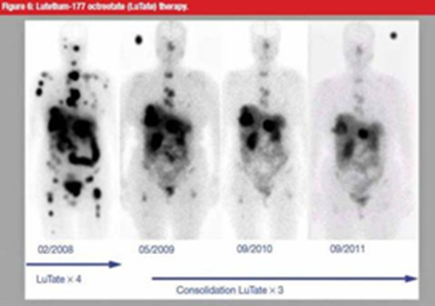
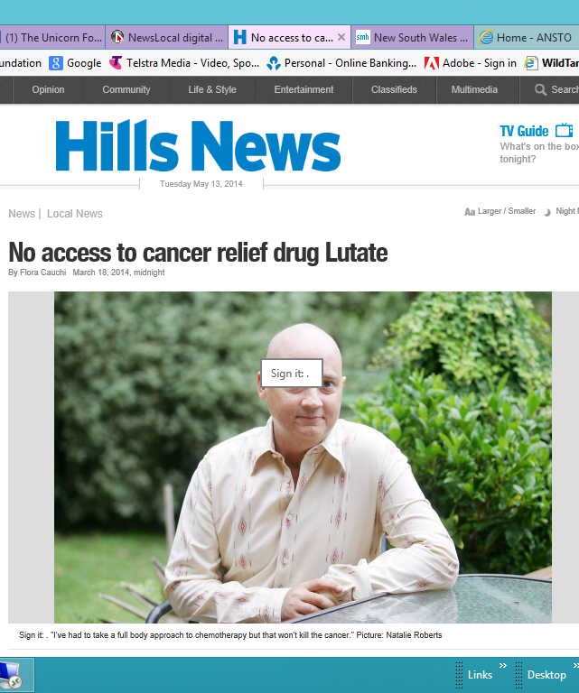
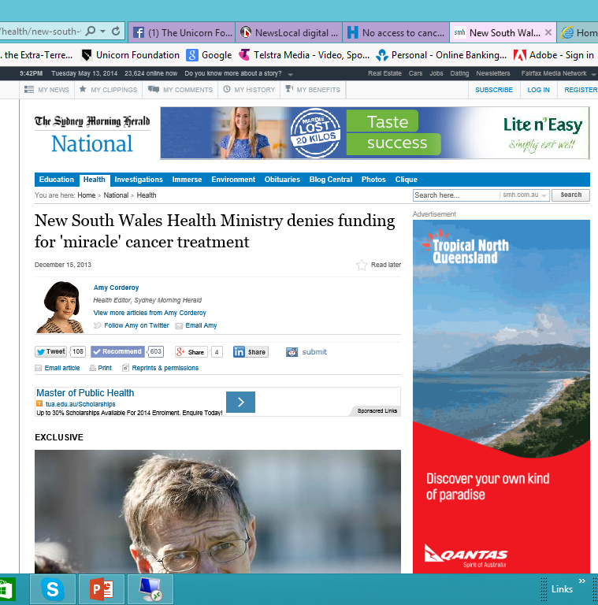
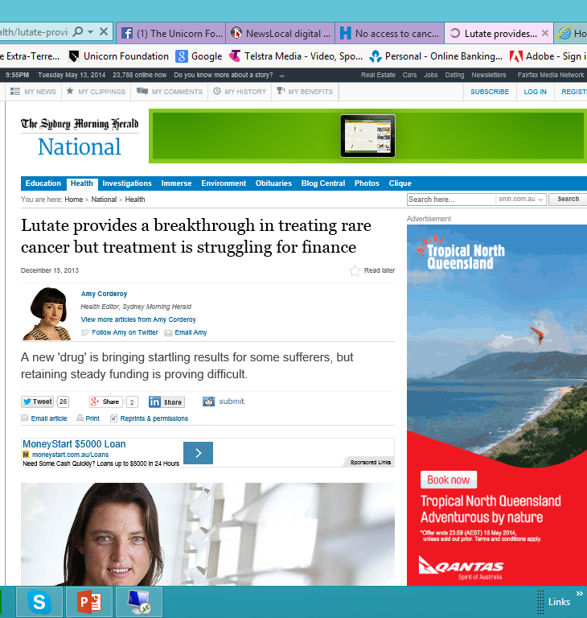

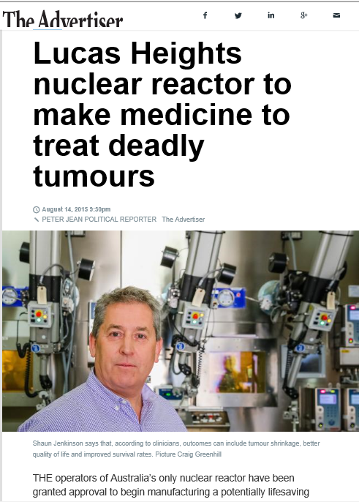

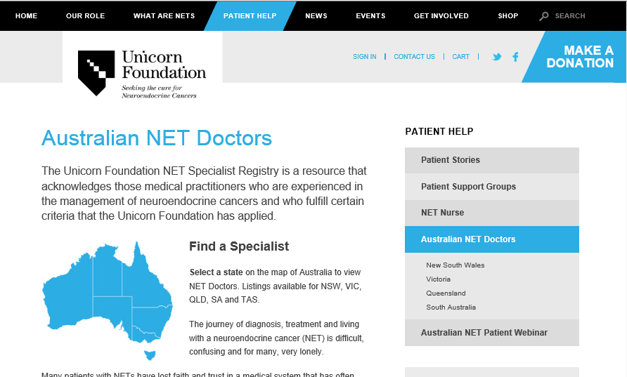
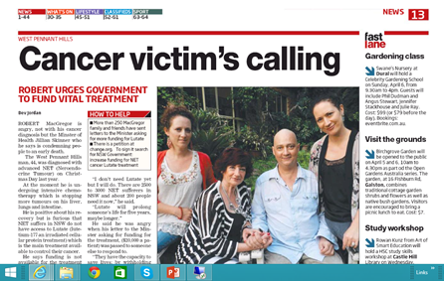
How can patient groups be part of the solution?

Slide 18
Key to success
You
Alliances
Get Involved
Lobby
Educate your supporters
Notes:
Alliance – Learn and Share
Time poor – still get involved
Lobby government for change – press stories
Use your best resource your supporters

