Slide 1
The role of the patient voice Health research and the HRC
Professor Kathryn McPherson
Chief Executive
kmcpherson@hrc.govt.nz

Slide 2
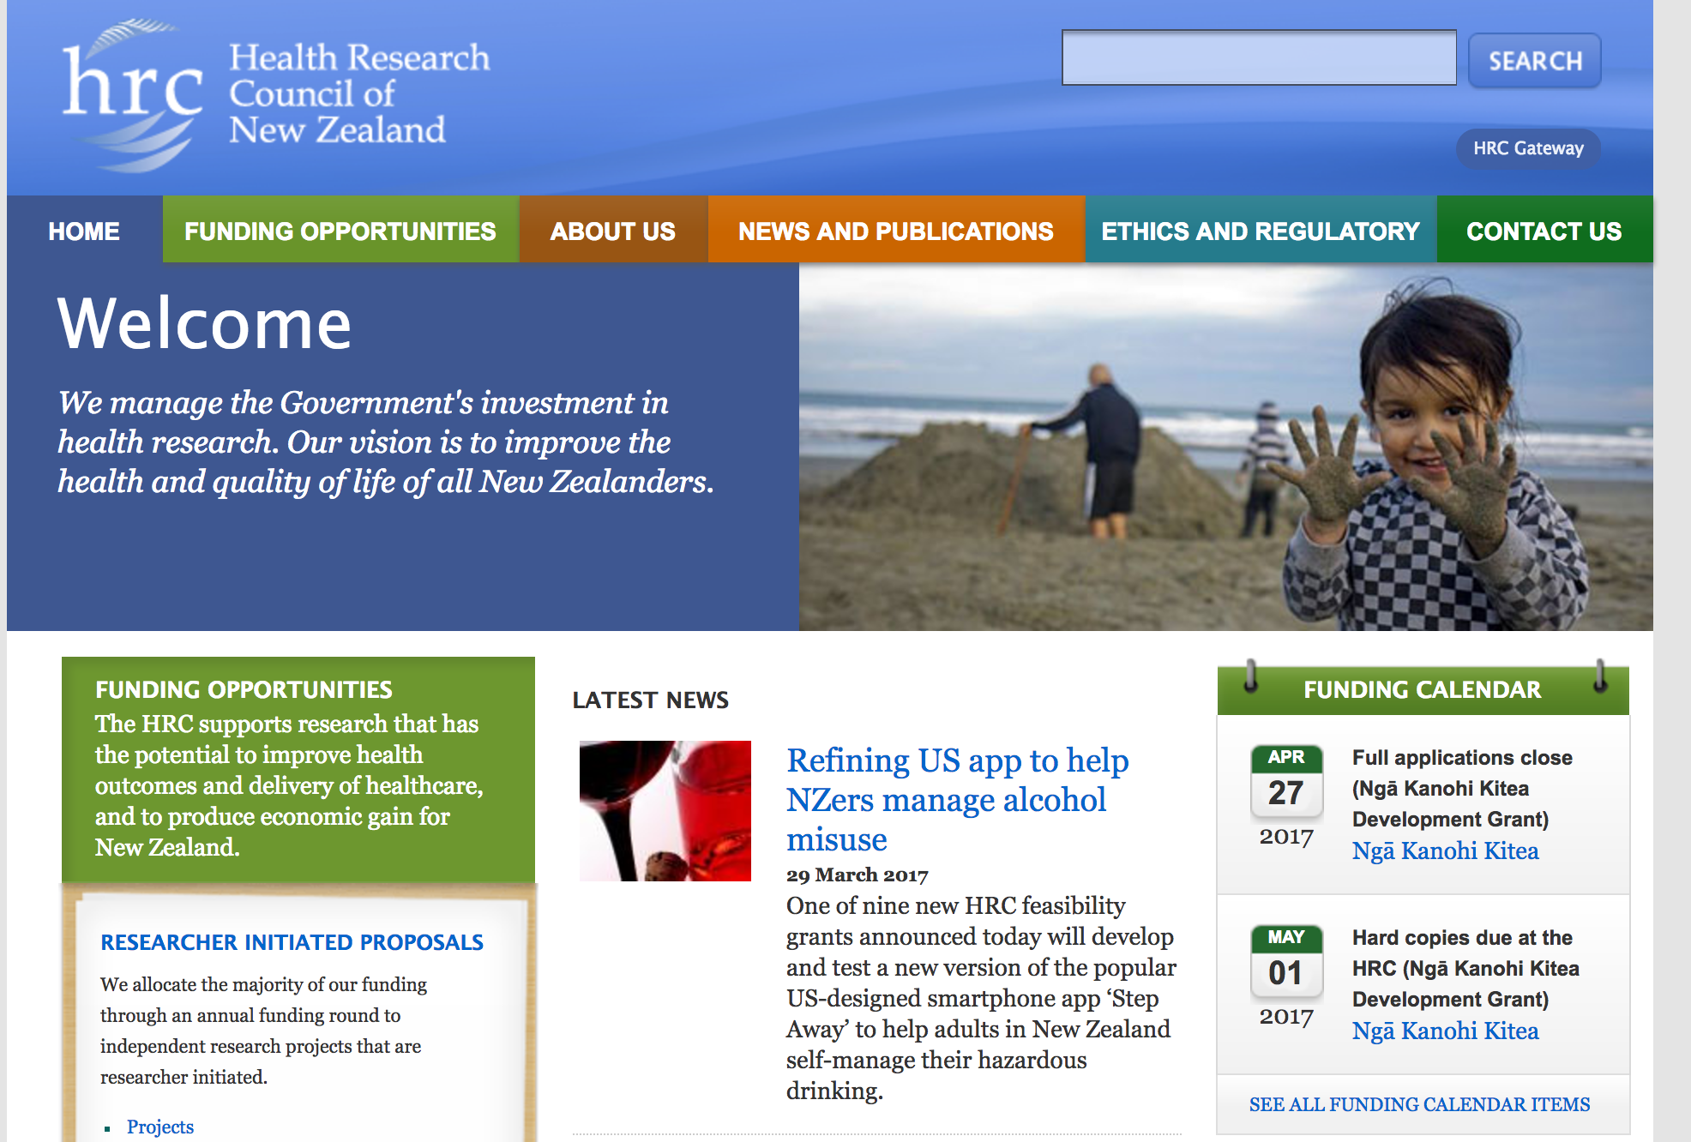
A bit of background (1)
What is the HRC (Health Research Council)?
The HRC is not (just) the Human Rights Commission
Government’s ‘main’ agency for managing investment in health research

Slide 3
What do we fund?
Biomedical, Public Health & Clinical research
Maori research
Pacific research
Health delivery and health services research
Capacity and capability building investment
Partnership investment
Many NGOs involved in this
International collaboration
At any one time resourcing nearly 3000 people
And NZ’s health researchers are amongst the best in the world

Slide 4
A bit of background (2)
A very happy health professional & researcher but…
Became CE of HRC in 2015
Concerned re investment (<1 in 10 chance of funding)
Two weeks after I started in March 2015
the strategic refresh of the HRC announced
intense scrutiny on the HRC since then
Significant opportunities therefore
Key outcomes of the refresh?
The system is complex and disaggregated
The HRC (in particular) was underfunded
The HRC was not visible in outcomes and impact
A NZ Health Research Strategy needed
Informed by stakeholder feedback

Slide 5
Where are we now?
May 2016 – a 56% increase in investment via the HRC from 2016-2018
Significant for the whole sector
A process to develop the NZ Health Strategy
Led by MBIE and MOH
Draft strategy with the ministers currently
Consultation directly influenced the strategy
The patient voice was part of that process
The strategy will directly inform HRC’s investment strategy
We are currently developing this

Slide 6
The patient voice in the consultation process?
Consultation meetings
27 representatives of NGO / not-for-profit at a range of meetings (+11 other individuals with no affiliation)
Written submissions
40 NGO / not-for-profit (the highest number of submissions)
Key feedback from these contributions
Partnership programme valued
Largely due to co-funding for key issues
involvement of consumers in shaping research priorities
service users as stakeholders in research (co-design)
Making a difference matters
Basic science valued
Patient stories valued

Slide 7
Areas of similarity and connection across all contributors
Prioritising equity of health outcomes
Enhancing collaboration and engaging users
Building a culture of research and innovation in the health sector
Engagement with Māori
Priorities for investment in health research needed
Focusing on research translation
Developing the health research workforce and research skills of health practitioners
Health and wellbeing as the key focus
A strong ethical foundation as core

Slide 8
Areas of difference?
Actually few markedly different – more about weight or emphasis eg
Researchers and universities strong on ‘excellence’ and the importance of international context
Variability around targeting health of NZ’ers specifically
NGO and patient feedback strongly supported this (in the main) versus researchers/TEOs prioritising investigator led research irrespective of this focus
DHB sector valued clinical research, health service delivery, implementation, evaluation and behavioural studies.
NGO/Not for profit - more emphasis than others on engaging more with communities

Slide 9
The patient voice in research in NZ?
Almost all health research needs people
researchers need (& value) patient participation in their studies
Patients (and consumers) as ‘partners’ is growing internationally and in NZ
We are seeing an increase in :
Research topic choice influenced by patient feedback
Patient reported outcomes as a key variable
Co-design being used in health delivery research
Steering groups involving patients from the outset (design)
Co-researcher model being used
We are developing our investment strategy
Patient voice is crucial for us in this (and for telling the impact story which - in turn influences government investment)

Slide 10
What do we need to enhance the patient voice in research?
Keen to hear feedback on this
We must ensure safe mechanisms
One patient on a steering group of 10 researchers can be uncomfortable for anyone!
We are looking at international models
Eg the NHMRC (Australia)

Slide 12
Getting this right matters (1)
By definition health impacts on patients (& families)
There is no such thing as an non-impactful interaction (not just interventions)
The same is true of health research
HRC is investing tax payer funds
The tax payer has a right to see value from that investment (and many patients are tax payers)
Some things are called patient centred but….
Is it the newest term to mean just about anything?
Person centredness is more than an ehealth record
A fabulous recent twitter feed on mistaking questionaires as being necessarily ‘patient centred’
Two key terms ‘polyformacy’ and ‘formacology’

Slide 13
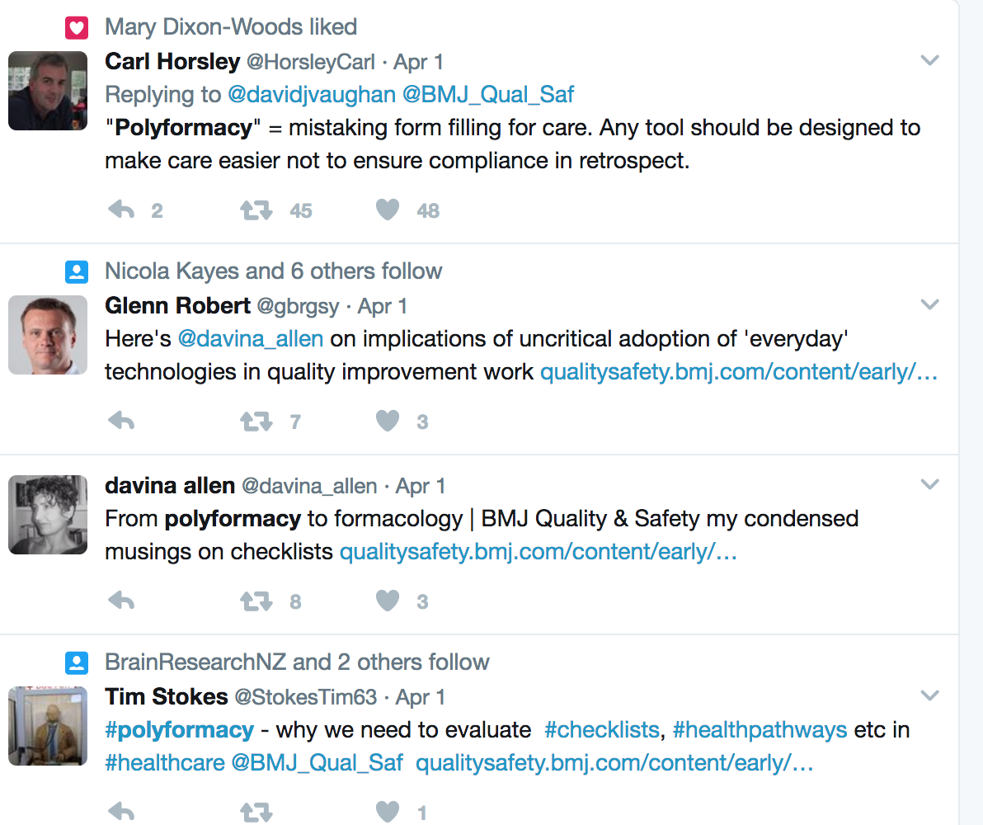

Slide 14
Getting this right matters (2)
It’s not that long since a decade of no increase
In effect a dramatic decrease
In the last election, only one party had anything on health research in its manifesto
Our board is committed to impact
Not throwing the baby out with the bathwater – keen to keep the baby AND significantly refresh the bathwater
We are working to raise the visibility of the impact of health research
Delighted to work with others on this
indeed we cannot do it alone
New Zealanders for Health Research now under way

Slide 15
To conclude
High engagement of multiple sectors in the HRC refresh and consultation on the strategy
Including the patient voice – and this will continue
Health research seems increasingly accepted as “everybody’s buisness”
A good thing
But expectations on the sector are high
HRC keen to play its part well
Supporting (and challenging) the health research and delivery sector to achieve our important mandate for NZ
it is all about people
the patient voice matters across the lifecycle of research to impact

Slide 16
Thankyou
Questions or feedback
kmcpherson@hrc.govt.nz
@katmcphe
@HRCNewZealand

