Slide 1
Economics of “health is a social investment”
Building a Sustainable Healthcare System
The Role of The Patient Voice Symposium
Wellington
4 April 2017
Dr Rupendra Shrestha
Senior Research Fellow
Faculty of Pharmacy
The University of Sydney

Slide 2
Collaborators
Prof Deborah Schofield, University of Sydney
Assoc Prof Megan Passey, University of Sydney
Prof Simon Kelly, University of Canberra
Richard Percival, University of Canberra
Prof Robert Tanton, University of Canberra
Dr Emily Callander, University of Sydney
Dr Michelle Cunich, University of Sydney
Prof Theo Vos, University of Queensland
Dr Lennert Veerman, University of Queensland

Slide 3
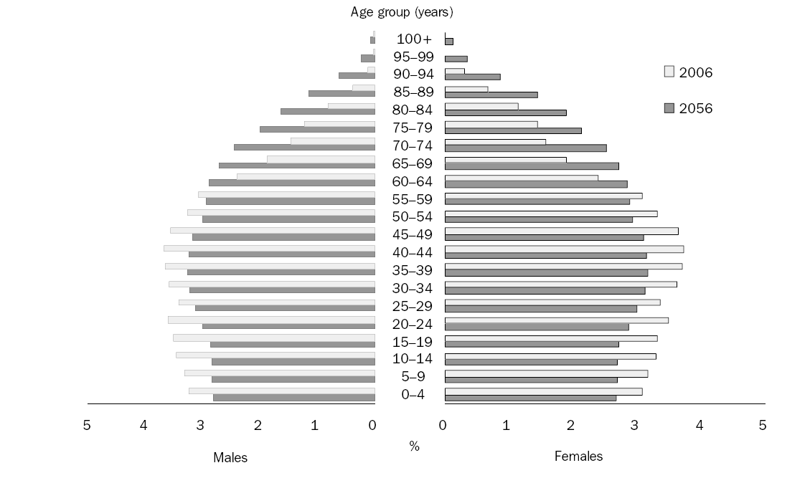
Population pyramid, Australia
Source: ABS (2008) Population Projections, Australia. Cat. No. 3222.0

Slide 4
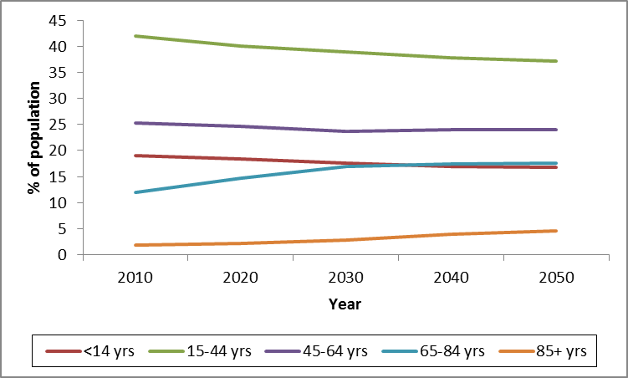
Demographic change
Australian Population projections (%)
Source: ABS (2008) Population Projections, Australia. Cat. No. 3222.0

Slide 5
Economic implications
Shrinking working age population
Aged-to-working age ratio increase
Increase dependency ratio
Source: Intergenerational Report 2010
2010: About 5 people of working age ~ one person of pension age (aged over 65)
2050: About 2.7 people of working age ~ one person of pension age (aged over 65)

Slide 6
Projections of Australian Government spending by category
Source: Intergenerational Report 2015

Slide 7
Sustainability of health spending
How much money will be available for health spending
How much pressure will health spending place on the future budget balance
Sustainability of future health spending
Places the future of health funding in the context of the future economy and budget balance

Slide 8
Ripple effects
Health is a social investment

Slide 9
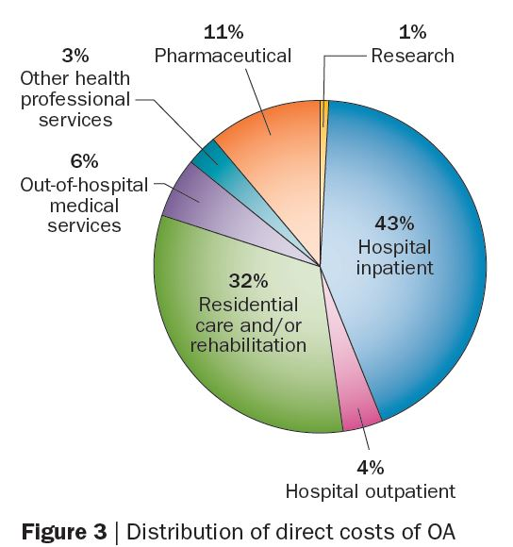
Direct costs of OA
Hunter et al. Nat Rev Rheumatol 2014, 10:437-441

Slide 10
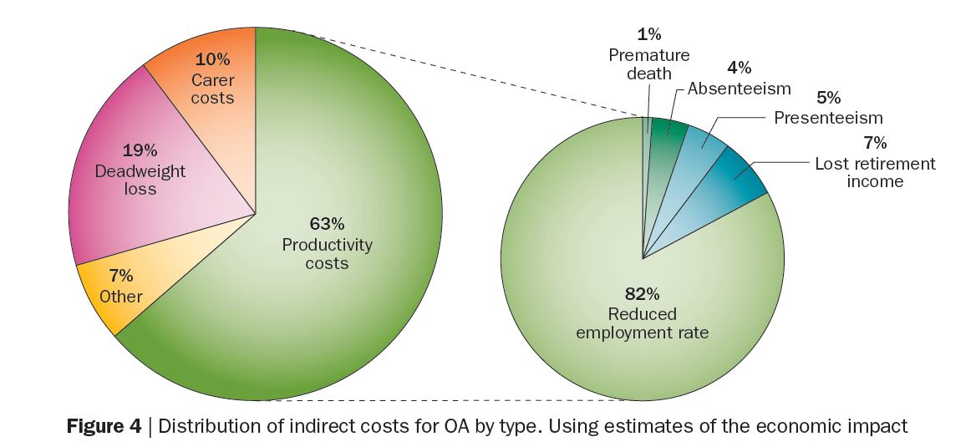
Indirect costs of OA
Hunter et al. Nat Rev Rheumatol 2014, 10:437-441

Slide 11
Health and labour force priorities
Health as a driver for labour force participation
Poor health excludes people from the labour force
58% of men and 26% of women who retire from full-time work early (before the age of 55 years) do so because of ill health.
Improving health to increase labour force participation

Slide 12
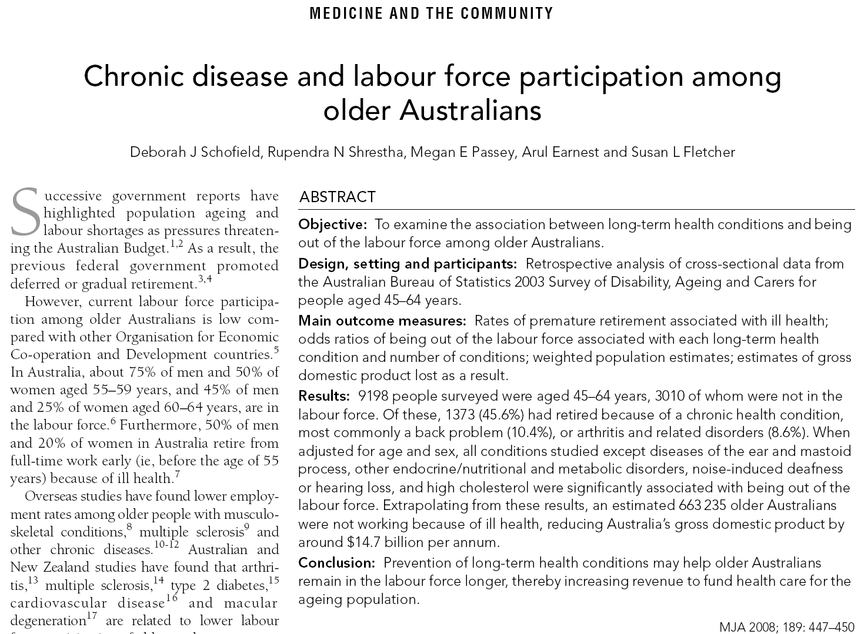
Impact of chronic disease on labour force participation

Slide 13
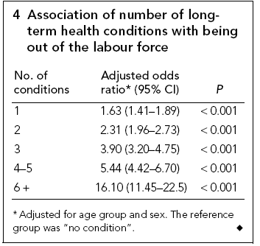

Slide 14
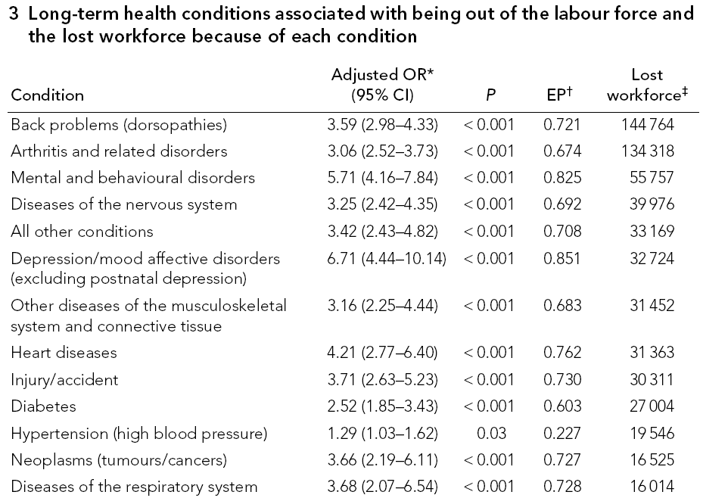

Slide 15
Total impact
The total number of Australians aged 45 to 64 not working due to a health condition was estimated to be 663,000 (14%) in 2003
This lost workforce reduced Australia’s GDP by around $12 billion per annum.

Slide 16
Costs of lost productivity
What are the impacts on personal incomes ?
How much tax is lost ?
How much extra social security payments are paid ?
What are the impacts on savings and lifetime living standards ?
What are the impacts on poverty ?
What impacts would interventions to treat chronic conditions have ?

Slide 17
Health&WealthMOD

Slide 18
Health&WealthMOD
Health&WealthMOD
Australian microsimulation model of health, income, savings, tax and government benefits.
Development of this economic model was funded by an ARC Linkage Project Grant with Pfizer Australia as an industry partner
It estimates:
lost income and savings, lost tax revenue and payment of benefits to those who have retired early due to illness.
the relative costs of diseases that lead to early retirement.

Slide 19
Cost of retiring early due to illness in Australia
Geometric means of weekly income, transfer payments and tax liability by labour force status for the Australian population aged 45-64 years, 2009
Labour force status | No in Survey | Income# | Transfer income$ | Tax liability!
Employed full-time | 4,266 (46%) | 1,167.0 | 0.2 | 166.3
Employed part-time | 1,738 (19%) | 482.9 | 0.9 | 8.9
Not in labour force due to ill health | 661 (7%) | 217.8 | 74.2 | 0.0
# including transfer income
$ including family payments
! including Medicare levy
Schofield et al. BMC Public Health 2011, 11:418

Slide 20
Cost of retiring early due to illness in Australia
National annual impact of persons not in the labour force due to ill health for the Australian population aged 45-64 years, 2009
 | Income# | Transfer payments$ | Tax liability!
Not in labour force due to ill health | 17,989,175,000 | 1,468,007,000 | 2,052,384,000
# including transfer payments
$ including family payments
! including Medicare levy
Note: Based on the differences between persons not in the labour force due to ill health and the weighted average of persons employed full time and part time.
Impact of ill health:
Exiting the workforce as a result of ill health is costly to both individuals and governments. The amount of lost income was significant, adding to the hardship experienced due to illness itself.

Slide 21
Cost of retiring early due to back pain in Australia
National annual impact of persons not in the labour force due to back pain for the Australian population aged 45-64 years, 2009
 | Income# | Transfer payments$ | Tax liability!
Not in labour force due to back pain (compared to those with no chronic condition and employed) | 4,816,000,000 | 622,200,000 | 496,900,000
Not in labour force due to back pain (compared to those with no back pain and employed) | 4,286,900,000 | 537,300,000 | 440,400,000
# including transfer payments
$ including family payments
! including Medicare levy

Slide 22
Diabetes and lost wealth
Odds ratios of having any wealth by different classes of wealth, Australians 45-64 years old, 2009, adjusted for age, gender and education
Labour force status | Total wealth | Income producing assets$ | Non-income producing assets#
Employed full-time, no health condition | Ref | Ref | Ref
Employed part-time, no health condition | 1.16 (0.27 – 4.94) | 0.45 (0.23 – 0.94) | 1.59 (0.99 – 2.56)
Not in labour force due to diabetes | 0.03 (0.00 – 0.30) | 0.09 (0.02 – 0.50) | 0.20 (0.06 – 0.71)
$ includes cash, superannuation, shares and property investments
# includes the value of owner occupied home
Schofield et al. Br J Diabetes Vasc Dis 2010, 10: 300-304

Slide 23
Chronic conditions and lost wealth
% difference (95% CI) in value of wealth, Australians 45-64 years old, 2009, adjusted for age, gender and education
Labour force status | Total wealth | References
Employed full time, no chronic condition | Ref
Not in labour force due to other mental illness | -93% (-98 – -71) | Schofield et al. Brit J of Psy 2011, 198: 123-128
Not in labour force due to back pain | -87% (-90 – -84) | Schofield et al. Eur Spine J 2011, 20: 731-736
Not in labour force due to CVD | -84% (-89 – -77) | Schofield et al. Int J Cardiol 2011, 146(1): 125-126
Not in labour force due to arthritis | -85% (-88 – -81) | Schofield et al. Rheumatology Int 2015, 35: 1175-1181
Not in labour force due to diabetes | -90% (-94 – -81) | Schofield et al. Br J Diabetes Vasc Dis 2010, 10: 300-304

Slide 24
Lifetime costs of exiting workforce early due to chronic conditions
Comparisons of actual total savings and annuity at age 65 for those not in the labour force due to ill health with the counterfactual total savings and annuity at age 65 if they were employed and had no chronic condition
 | Total savings (cash, super, shares, other property) at age 65 |  |  | Annuity at age 65
 | Mean ($) | Median ($) |  | Mean ($) | Median ($)
Male, 45 – 54
Actual | 56,740 | 1,810 |  | 3,280 | 100
Counterfactual | 377,330 | 249,160 |  | 21,800 | 14,400
Male, 55 – 64
Actual | 145,710 | 34,400 |  | 8,420 | 1,990
Counterfactual | 322,220 | 208,220 |  | 18,620 | 12,030
Female, 45 – 54
Actual | 76,100 | 830 |  | 3,850 | 40
Counterfactual | 246,480 | 170,040 |  | 12,470 | 8,600
Female, 55 – 64
Actual | 103,440 | 9,410 |  | 5,230 | 480
Counterfactual | 189,200 | 120,650 |  | 9,570 | 6,100
Kelly et al. The Economic Record 2012, 88(283):576-584

Slide 25
Summary
Chronic conditions are associated with people being out of the labour force
Economic costs of labour market withdrawal because of ill health (costs of productivity lost) are substantial.
In addition to the health burden caused by these conditions, they also contribute to economic disadvantage due to impacts on labour force participation.
People who retire early due to chronic condition are left with reduced savings to finance their retirement years resulting in lower living standards in retirement.
Exiting the workforce as a result of ill health is costly not only to individuals and but also to governments (i.e. lost tax revenue and increased transfer payments)

Slide 26
Health&WealthMOD
What will be the economic impacts of early retirement due to ill health in future?
Health&WealthMOD: a cross-sectional model
Does not capture the long-term impacts of
demographic change
the changing labour force participation patterns of older working aged population
change in wealth accumulation patterns
trends in major chronic conditions affecting the older workforce

Slide 27
Health&WealthMOD2030

Slide 28
Health&WealthMOD2030
Purpose
Funded by ARC linkage project grant with Pfizer Australia as an industry partner
A microsimulation model of long term economic impacts of ill health on older working aged Australians and the Australian government
Takes into account the significant socio-demographic and economic changes and trends in major chronic conditions predicted to occur between 2010 and 2030
Estimates the economic impacts of early retirement due to ill health to individuals and the government in every five years from 2010 to 2030

Slide 29
Productive life years
Labour force status of Australians aged 45-64 years projected to 2030
Labour force status | 2010 | 2015 | 2020 | 2025 | 2030 | Growth (%)
Employed full-time with a chronic condition | 1,452,000 | 1,565,000 | 1,722,000 | 1,830,000 | 1,962,000 | 35.1
Employed full-time without a chronic condition | 1,572,000 | 1,653,000 | 1,786,000 | 1,864,000 | 2,017,000 | 28.3
Employed part-time with a chronic condition | 621,000 | 682,000 | 769,000 | 825,000 | 888,000 | 43.0
Employed part-time without a chronic condition | 501,000 | 536,000 | 594,000 | 632,000 | 688,000 | 37.3
Productive Life Years (PLYs) lost due to chronic conditions | 347,000 | 380,000 | 413,000 | 434,000 | 459,000 | 32.3
Total Population | 5,580,000 | 5,945,000 | 6,374,000 | 6,677,000 | 7,130,000 | 27.8

Slide 30
GDP lost
Estimated loss of GDP due to productive life years lost caused by chronic ill health in Australians aged 45-64 years, ($ billions)
2010 | 2015 | 2020 | 2025 | 2030
37.8 | 44.5 | 50.5 | 56.4 | 63.7
Schofield et al. MJA 2015, 203(6): 260.e1:e6

Slide 31
Projections of cost of retiring early due to illness
Schofield et al. BMJ Open 2016

Slide 32
Impact of diabetes prevention on labour force participation
(Passey et al. BMC Public Health 2012, 12:16)

Slide 33
Objective
To investigate the impact on labour force participation and personal incomes of diabetes intervention using a screening program and metformin or lifestyle intervention for those identified as pre-diabetics
Estimated the extra number of years in the labour force and increase in personal incomes of Australians aged 45 – 64 years in 2003, who would not have developed diabetes if a screening and intervention program to prevent the onset of diabetes were in place for the 20 years from 1983

Slide 34
Impacts of intervention to prevent diabetes
Increased number of person years in the labour force & the associated increase in total incomes over the ten years
 | Age group in 2003 | Using metformin |  | Lifestyle intervention
 |  | Total person years | Total income | Total person years | Total income
Male | 45-49 | 28 | 1,263,000 | 43 | 1,896,000
 | 50-54 | 97 | 4,319,000 | 125 | 5,595,000
 | 55-59 | 282 | 12,578,000 | 358 | 15,967,000
 | 60-64 | 683 | 30,486,000 | 753 | 33,599,000
Female | 45-49 | 11 | 347,000 | 11 | 347,000
 | 50-54 | 42 | 1,329,000 | 42 | 1,329,000
 | 55-59 | 679 | 21,629,000 | 816 | 25,983,000
 | 60-64 | 790 | 25,144,000 | 890 | 28,334,000
Total |  | 2,612 | 97,095,000 | 3,038 | 113,049,000
$44,600 per
person per year
$31,800 per
person per year

Slide 35
Summary
Health is a social investment.
Investment in health can result in savings in other portfolios in addition to health.
Preventing / managing chronic conditions is one way to increase the workforce to grow economy.
This may contribute towards a sustainability of the future health funding.

Slide 36
Thank you !!!

